Slide 1



capstone project phase A
ShopLINK
supervisor: Dr. Zakharia Frenkel
Presented by:
Julia Shbat
Daniel Vardimon
Notes:
Hello everyone, today we will be presenting our project, ShopLINK . My name is Julia Shbat, and my partner is Daniel Vardimon. Our supervisor is Dr. Zakharia Frenkel."

Slide 2







Motivation
Businesses struggle to manage the flood of messages, leading to delayed responses and dissatisfied customers.
Businesses manually manage advertisements and customer segmentation, leading to inefficiencies and missed opportunities.
Notes:
We chose this topic because As businesses handle more customer interactions through WhatsApp, managing conversations becomes increasingly overwhelming. This can lead to delayed responses and missed marketing opportunities. That's why we need an efficient, automated solution to organize chats, ensure timely responses, and deliver targeted marketing, so businesses can maintain quality communication while scaling their operations.
Additionally, businesses face the challenge of targeting the right customers with appropriate advertisements. As customer bases grow, it becomes increasingly difficult to manually manage and personalize marketing efforts. There is a need for an efficient, automated solution that not only manages customer communications but also intelligently clusters customers based on their interests for targeted marketing.

Slide 3

RELATED WORKS
Our app stands out in the competitive field of WhatsApp workflow management by offering advanced features beyond those provided by current solutions like Zoko, Zixflow, and Interact.... While these apps provide essential tools like bulk messaging and basic customer management, our app incorporates next-level clustering and topic extraction algorithms, personalized customer engagement, and a powerful analytics dashboard that delivers actionable insights.
Notes:
With a more intuitive interface and deeper integration of automation, our app truly empowers businesses to manage WhatsApp interactions more efficiently and strategically.

Slide 4
INTRODUCTION
ShopLINK is a business solution that helps companies manage customer interactions via WhatsApp, addressing communication overload and automating marketing efforts.
Notes:
ShopLINK is a business solution that helps companies manage customer interactions via WhatsApp, addressing communication overload and automating marketing efforts.

Slide 5


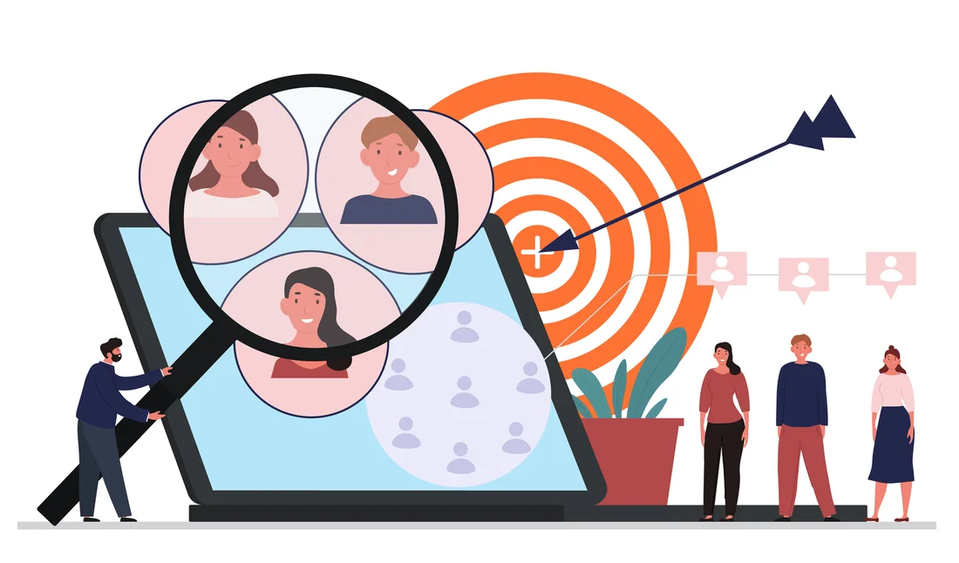

OUR SOLUTION
ShopLINK leverages chatbot, NLP, and API integrations to handle customer interactions, segment users, and automate marketing.
Features
Automated Response System.
Customer Segmentation
Product Catalog Management
Notes:
Our platform offers three core features: an automated response system, customer segmentation and product catalog management.

Slide 6

Automated Response System
Automates customer queries via WhatsApp using Twilio API.

Slide 7

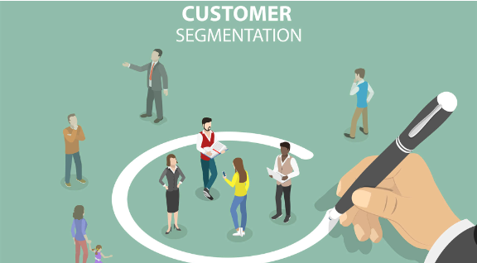
Customer Segmentation
Analyzes customer data and clusters them using MeaningCloud API Text Classification.

Slide 8

Product Catalog Management
Manages and updates product information via Whapi API.

Slide 9








System Architecture
MERN
APIs
BACK-END NODEJS and Express
BACK-END MONGODB
Twilio for messaging
MeaningCloud for text analysis
Whapi for product catalog
Tax Authority for compliance
FRONT-END REACT-JS
VISUAL STUDIO CODE FRAMEWORK

Slide 10









TECHNOLOGY CHALLENGES
User interface design for ease of use.
Scalability to manage increased traffic
Optimizing system performance for real-time interactions
Ensuring security for customer data and transactions.

Slide 11

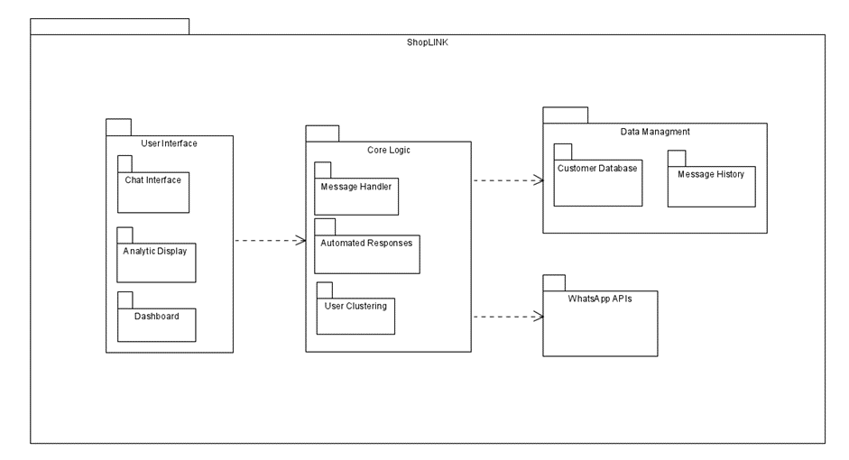
System Architecture
Package Diagram

Slide 12
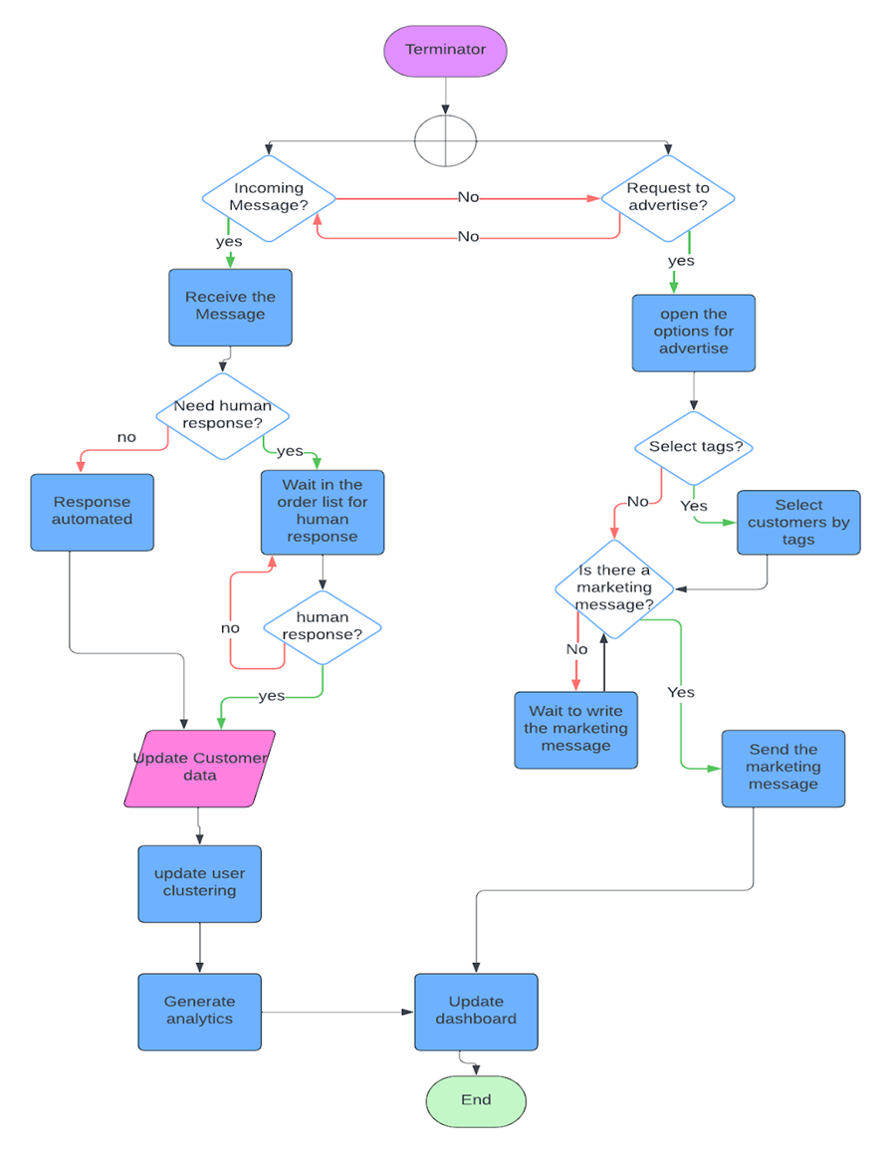
FlowChart

Slide 13

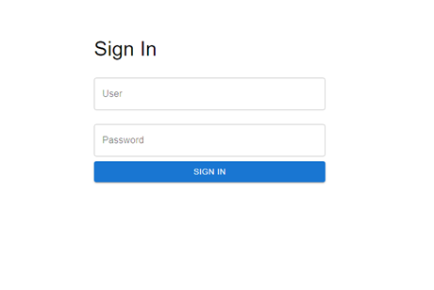
Interface

Slide 14
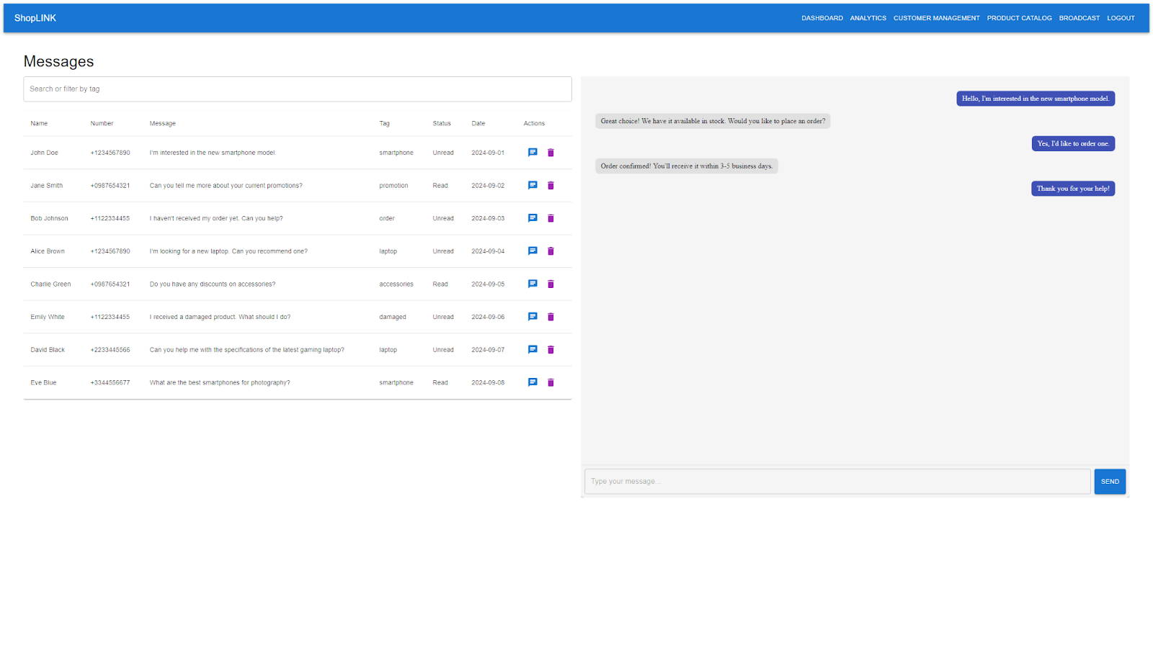
Interface

Slide 15
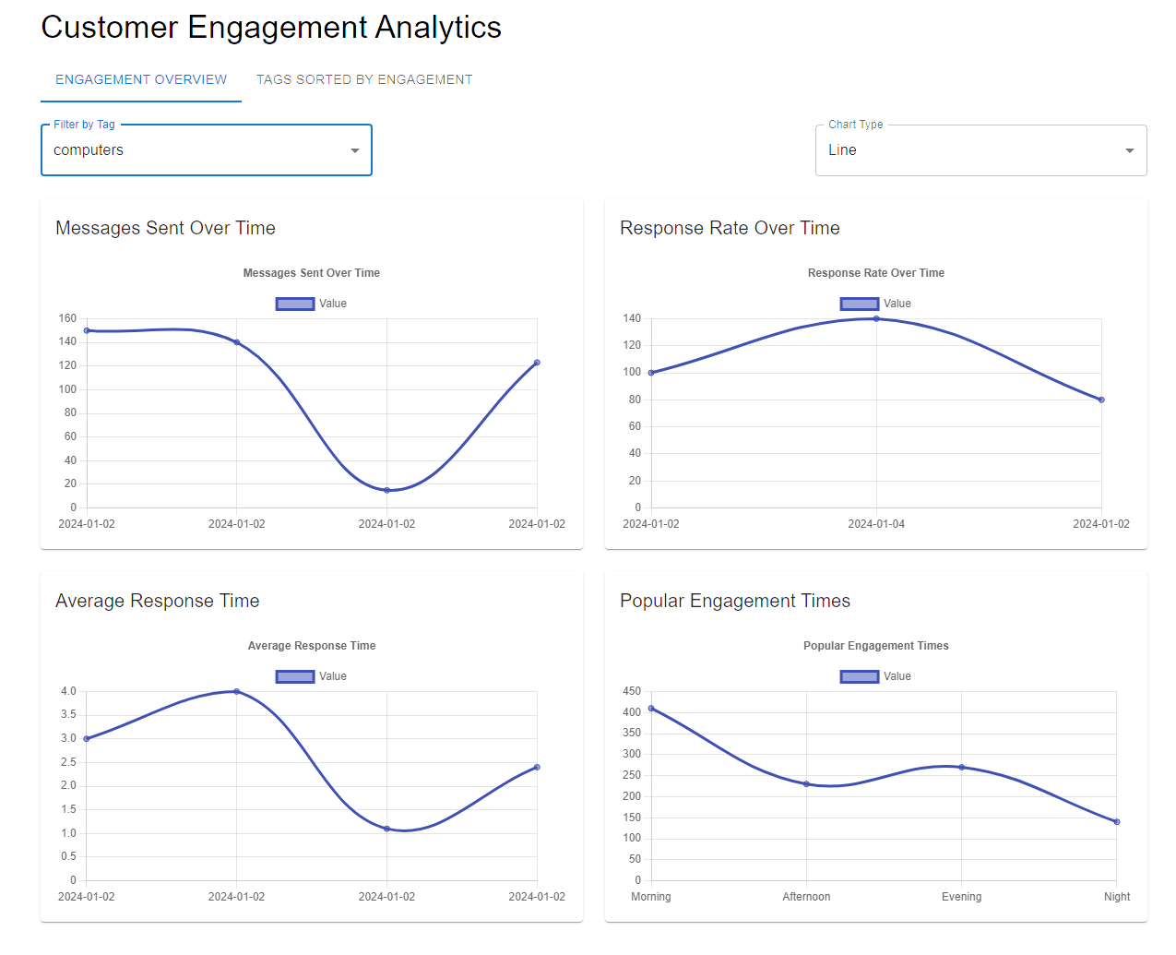
Interface

Slide 16
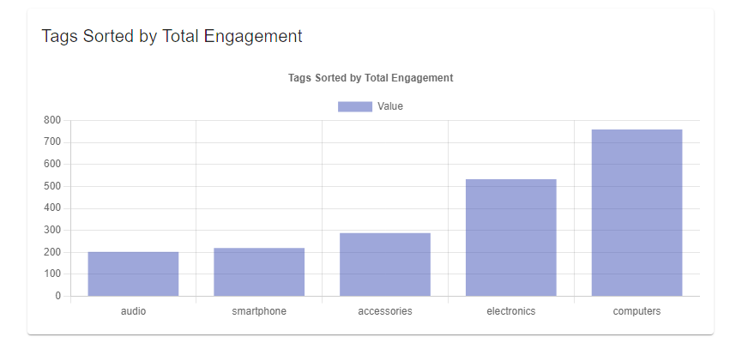
Interface

Slide 17
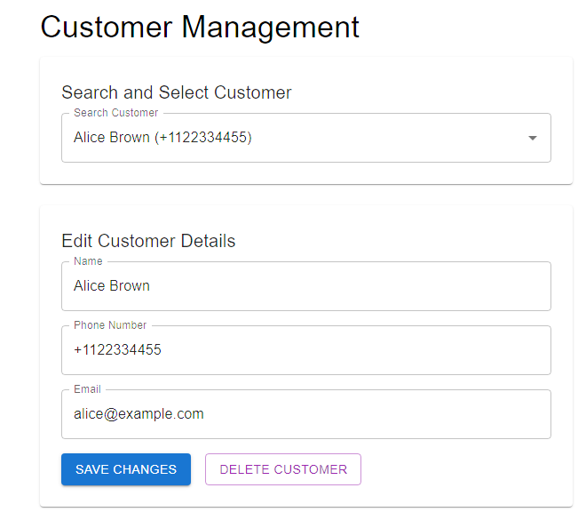
Interface

Slide 18
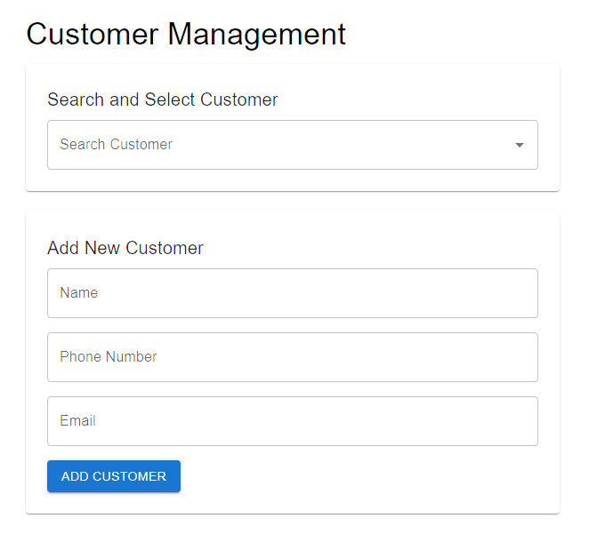
Interface

Slide 19
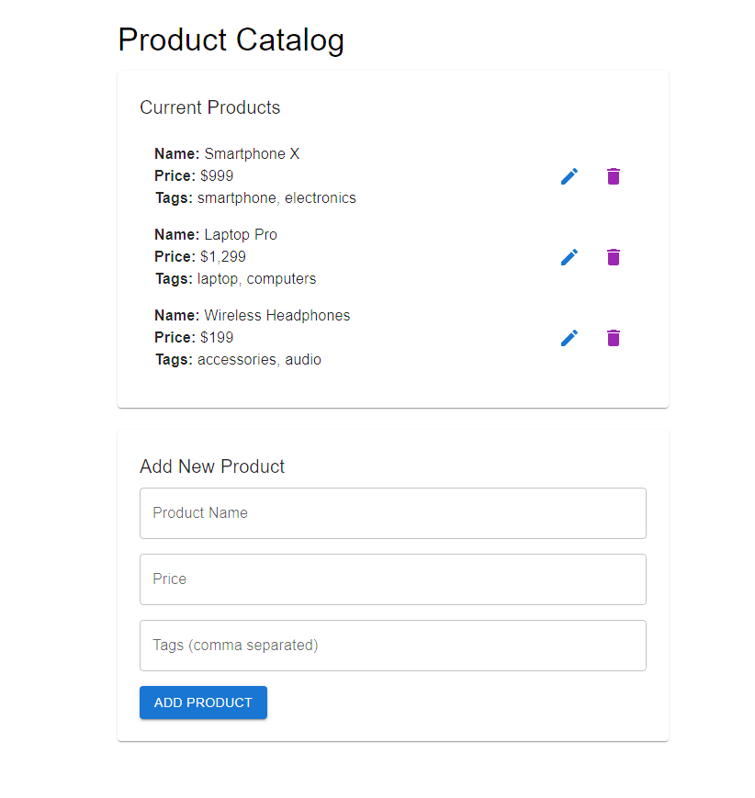
Interface

Slide 20
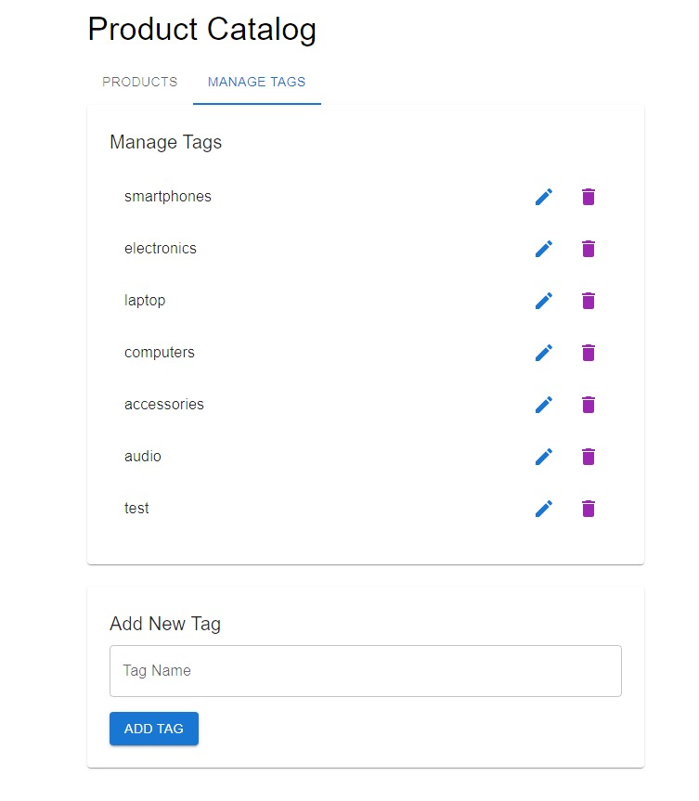
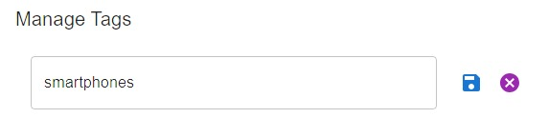
Interface

Slide 21
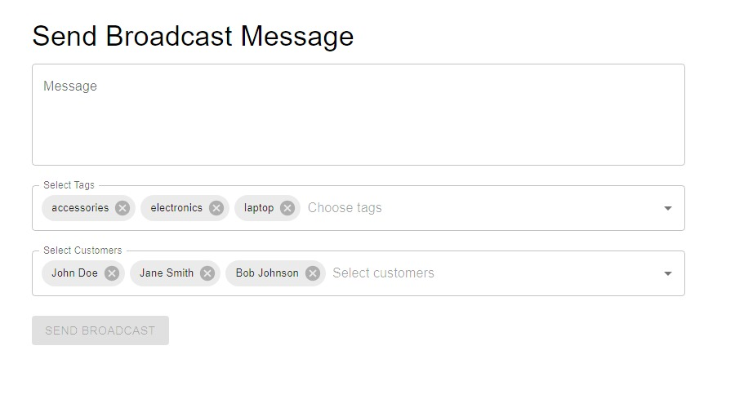
Interface

Slide 22
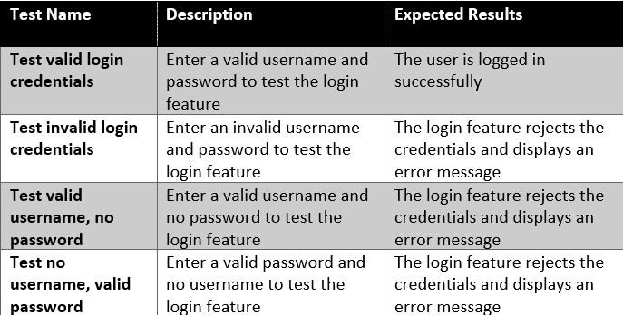
Testing Plan
LOGIN TESTS

Slide 23
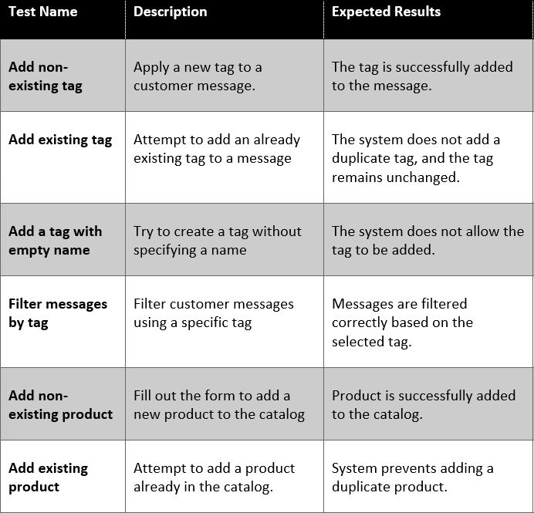
MANAGER TESTS

Slide 24
Conclusion
In conclusion, ShopLINK offers a scalable solution for businesses to manage their customer interactions on WhatsApp, automate responses, and segment customers for targeted marketing. Our system is user-friendly and integrates seamlessly with existing tools like WhatsApp

Slide 25

THANK
YOU

